Slide 1
Inference Statistics Slides
June 11, 2020
by Alberto Gutierrez

Slide 2
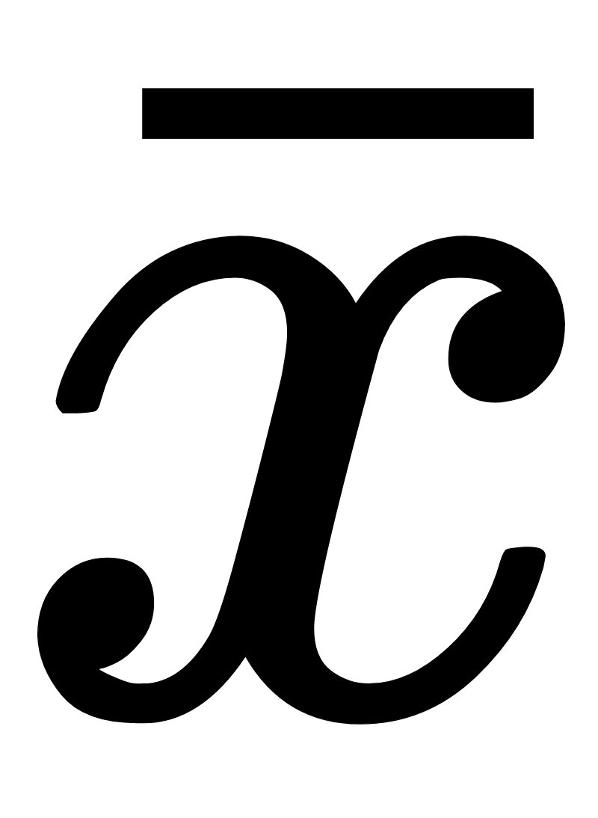
Decision Statistics Summary
Decision Type
Distribution Type
Mean or Proportion
Inference (decision) Type |  | Normal Distribution |  | t-Distribution
 |  | Difference in the Mean | Difference in Proportion | Difference in the Mean | Difference in Proportion
Confidence Interval to some specified percentage around the mean or proportion |  | -----+---------- -----------+------ <...95%, 90% …>
Hypothesis Testing |  | H₀ : (Null Hypothesis), expected result, H_{A} : Alternative Hypothesis, the assertion or claim E.g. The null hypothesis maintains the advertised weight of 700 Troy ounces. H₀ the weight is ≥ K . Alternative H_{A} < K (650 Troy ounces)
One-sample statistics e.g., the weight of a sample of gold bars sampled from pallet |  | Default or null hypothesis always states that the sample mean is equal to the expected or advertised mean. The assertion or alternative hypothesis always states that the sample mean is different than the expected mean.
Two-sample statistics e.g. 2 “sub” populations w and w/o cancer |  | A/B test. Is the click rate on web page A different than click rate on web page B?

Slide 3
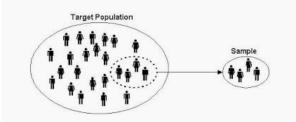
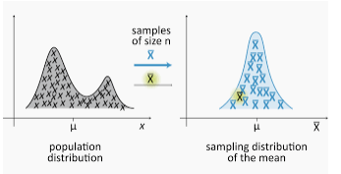
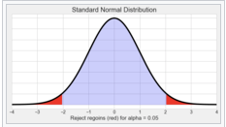
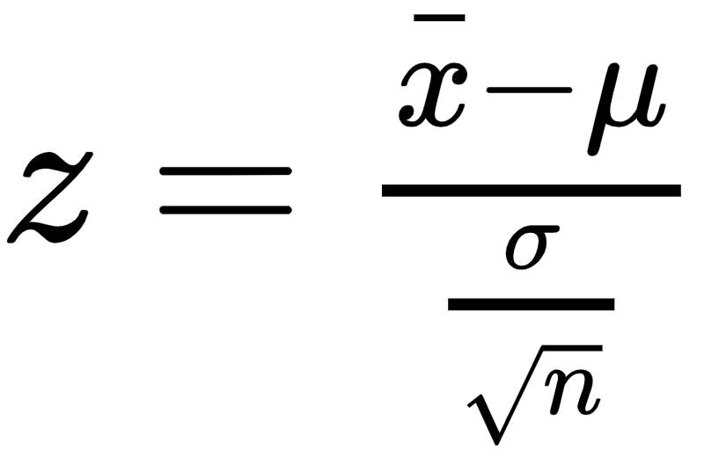
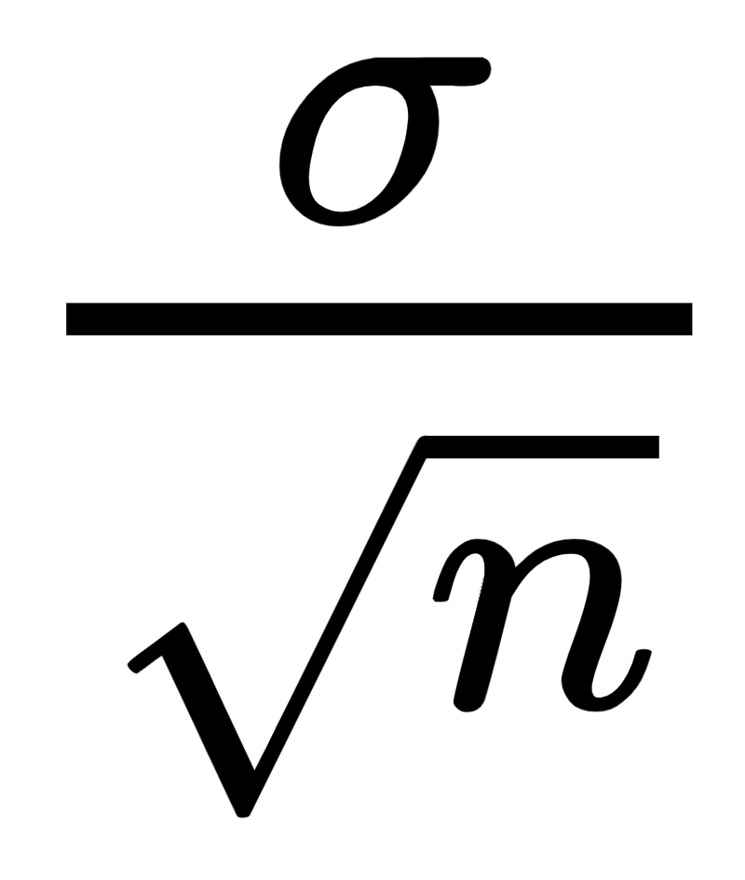
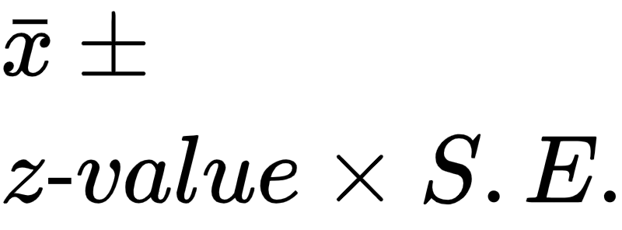
Central Limit Theorem
This theorem is the primary reason why the normal distribution appears in so many statistical results. The theorem can be stated as follows.
For any population distribution with mean μ and standard deviation σ, the sampling distribution is approximately normal with mean μ and standard deviation σ/sqrt(n), and the approximation improves as n increases.
Z ~ Ɲ(μ,σ/√n)
z “statistic” or “z-value” is sample mean converted to the z-axis
Normal Distribution
Many textbooks suggest n ≥ 30 as a rule of thumb. However, this depends heavily on the population distribution.
If the population distribution is very non-normal—extremely skewed or bimodal, for example—the normal approximation might not be accurate unless n is considerably greater than 30. if the population distribution is already approximately symmetric, the normal approximation is quite good for n considerably less than 30.
In the special case where the population distribution is normal then the sampling distribution is normal.
Sample Standard Deviation
S.E =
The sample standard deviation is also called the “standard error” and abbreviated S.E.
Confidence Interval
http://sphweb.bumc.bu.edu/otlt/MPH-Modules/BS/BS704_Probability/BS704_Probability12.html

Slide 4
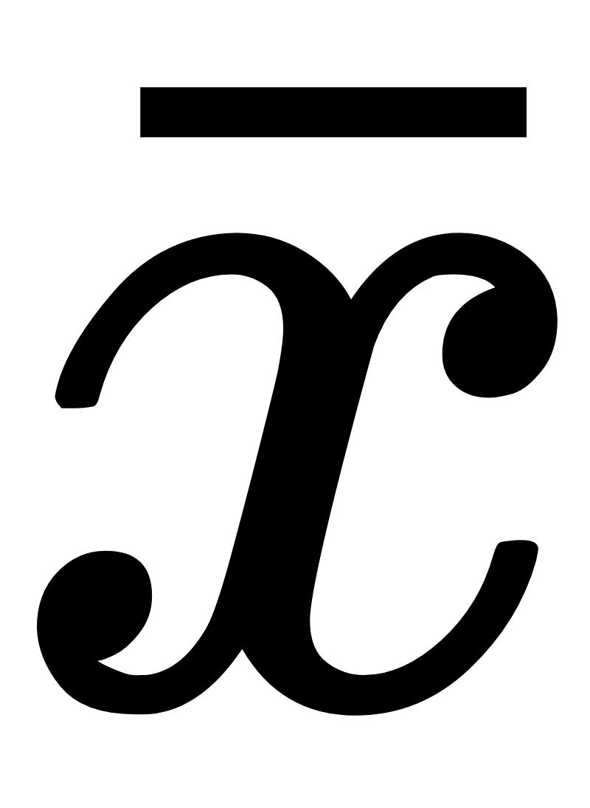
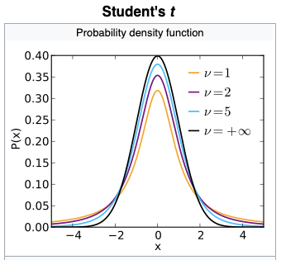
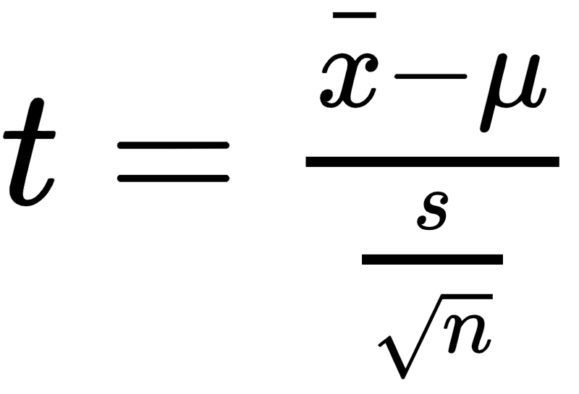
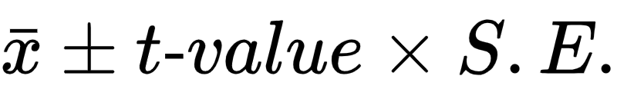
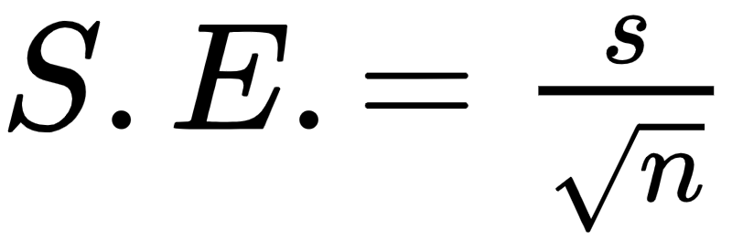
t-distribution: What happens if don’t meet the assumptions for a Normal Distribution?
When to use the t-distribution
When the population standard deviation, σ, is not known (usually the case)
and or when n < 30
What is a t-distribution?
The t-distribution has larger tail than Normal distribution resulting in less confidence as compared to Normal distribution,
For large n it converges with the Normal distribution.
It has a degrees of freedom “df“ (or “ν”) = n -1 samples
William Sealy Gosset published it in 1908 under the pen name “Student” for testing population means for low n and unknown standard deviation
How is it used?
Confidence Interval
Hypothesis Tests
General Example
Start with n samples from a population
Find the sample mean and sample standard deviation
Use the t-value equation get t
Lookup the p-value (area under the tail) corresponding to the confidence level α and degrees of freedom df, p = f(t,df)
-t-value (“t-statistic)
t-value (“t-statistic)
t-statistic for population means
Confidence interval
s = sample mean

Slide 5
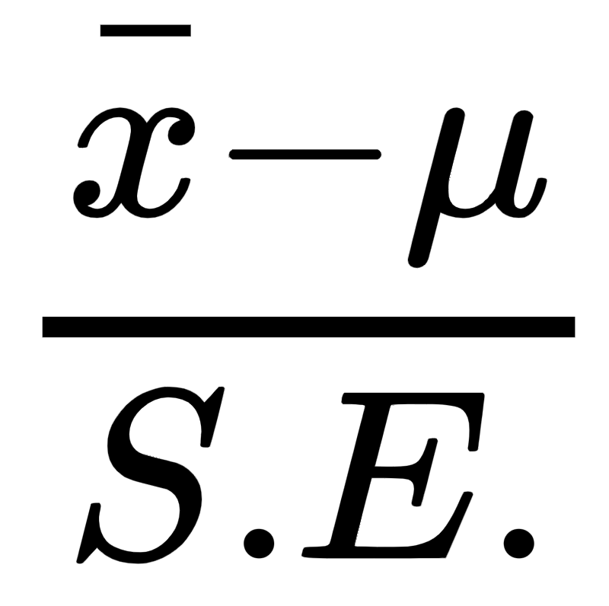
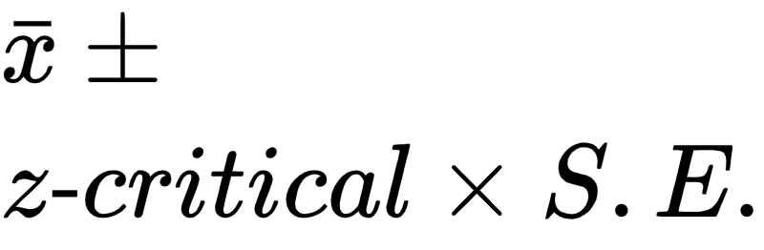
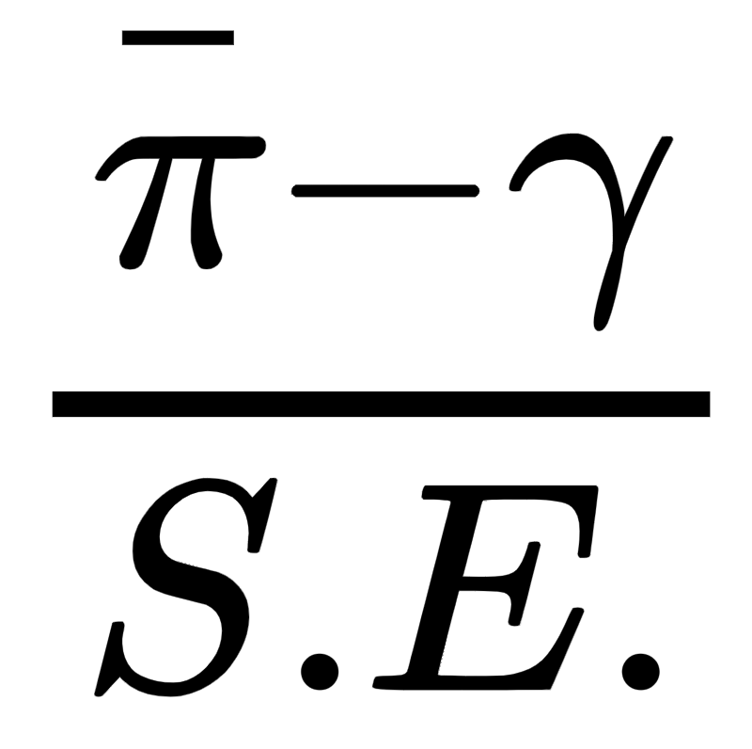
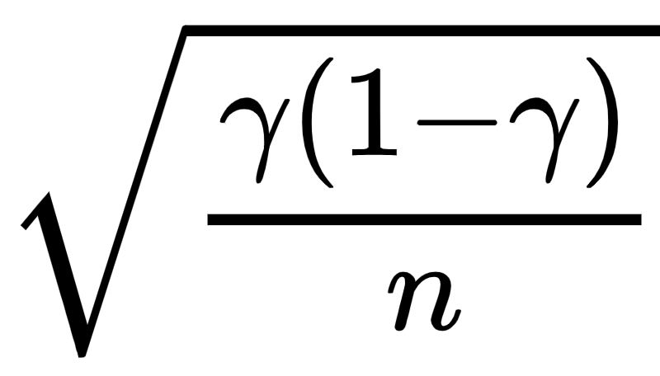
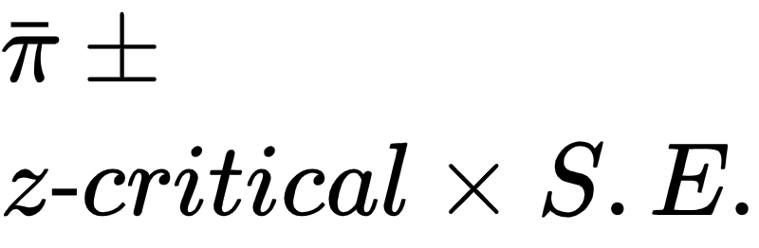
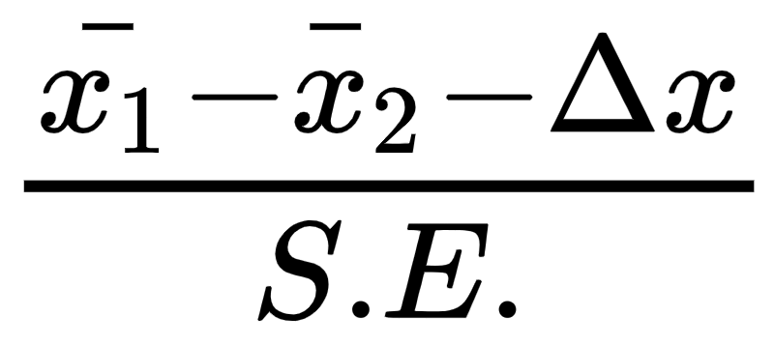
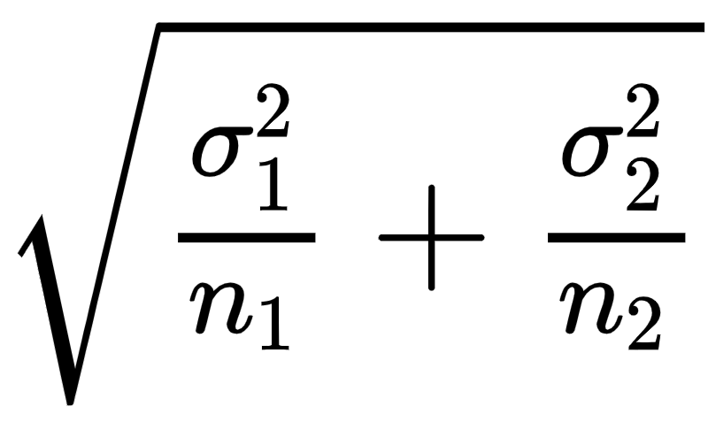
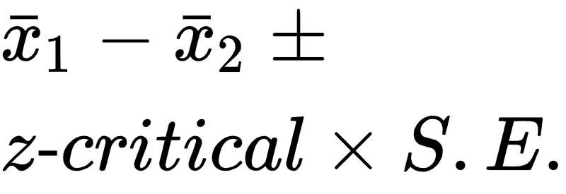
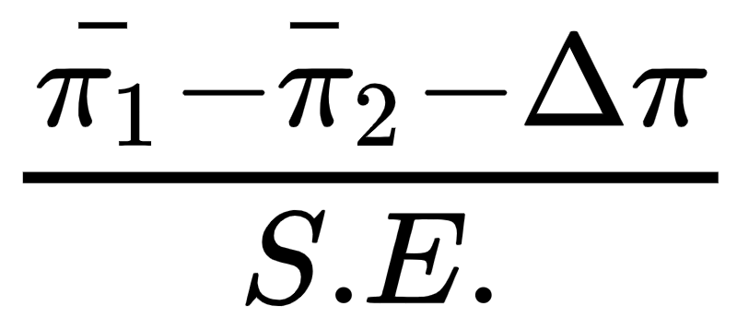
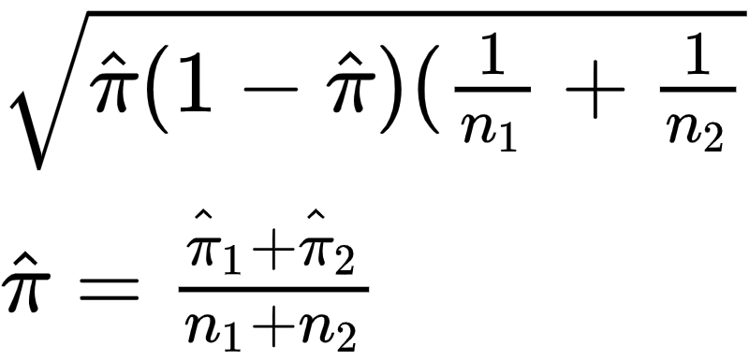
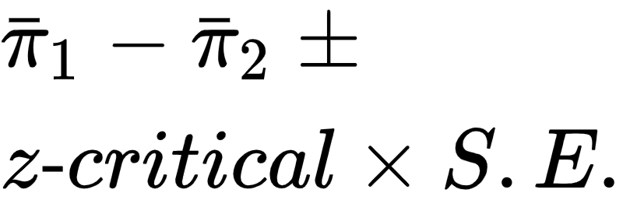
z-statistics, One Sample and Two-Samples
z-test statistics normally distributed, standard deviation(s), σ, are known or lots of samples for a good estimate, n_{i} >> 30, otherwise use t-test
Statistic | z-statistic (z-value) | S.E. | Confidence Interval z-critical demarks tail of Normal distribution | Hypothesis Question | Hypothesis One or Two - sided
Sample Mean (quantitative data) |  |  |  | Sample mean is = μ or different (> or <) than the expected mean, μ= X | H₀: μ = X or, μ ≤ X or μ ≥ X X is the advertised mean
Sample Proportions (qualitative data) |  |  |  | Sample proportion (e.g., coin heads proportion) = or different (> or <) than the expected hypothesized proportion, γ=Y | H₀: γ = Y or, γ ≤ Y or γ ≥ Y Y is the advertised proportion
Two- Sample Means (qualitative data) |  |  |  | The difference of two samples means (e.g., avg blood cell counts for two different populations, w and w/o cancer) μ₁ - μ₂ differ by a hypothesized amount (μ₁ - μ₂ = Δx) or are less than or equal to a hypothesized amount Δx. | H₀: μ₁ - μ₂ = Δx or, μ₁ - μ₂ ≤ Δx or μ₁ - μ₂ ≥ Δx
Two- Sample Proportions (quantitative data) |  |  |  | The difference of two sample proportions (e.g., click rate proportion for web page A and B, two different populations) π₁ - π₂ differ by a hypothesized amount (π₁ - π₂ = Δπ) or are less than or equal to a hypothesized amount Δπ. | H₀: π₁ - π₂ = Δπ or, π₁ - π₂ ≤ Δπ or π₁ - π₂ ≥ Δπ π1 and 2 are sample proportions

Slide 6
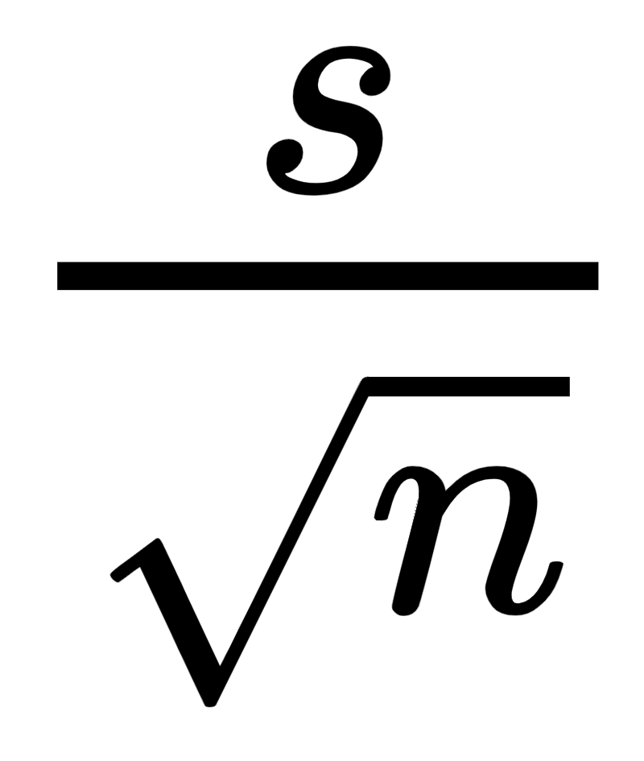
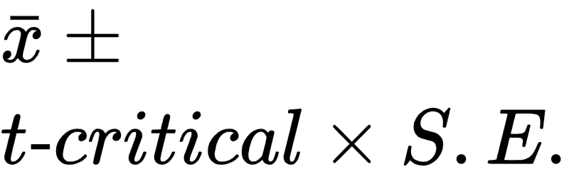
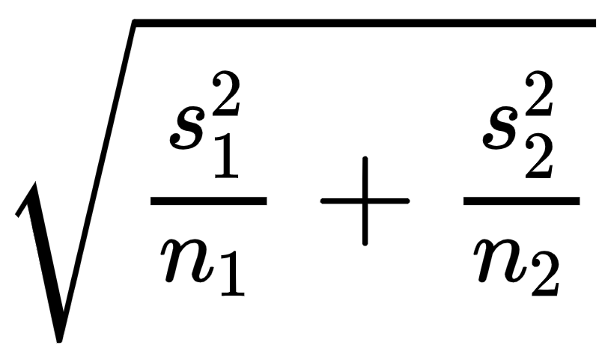
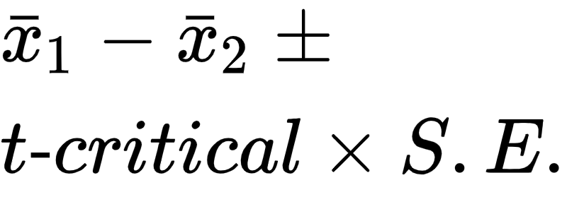
t-statistics, One Sample and Two-Samples
standard deviation(s), σ, are not known
n < 30
Statistic | t-statistic (t-value) | S.E. | Confidence Interval t-critical demarks tail of t distribution | Hypothesis Question | Hypothesis One or Two - sided
Sample Mean (qualitative data) |  |  |  | Sample mean is = μ or different (> or <) than the expected mean, μ= X | H₀: xbar = μ or, x_bar ≤ μ or x_bar ≥ μ
Two- Sample Means (quantitative data) |  |  |  | The difference of two samples means (e.g., avg blood cell counts for two different populations, w and w/o cancer) μ₁ - μ₂ differ by a hypothesized amount (μ₁ - μ₂ = Δx) or are less than or equal to a hypothesized amount Δx. | H₀: μ₁ - μ₂ = Δx or, μ₁ - μ₂ ≤ Δx or μ₁ - μ₂ ≥ Δx
https://www.sgapeio.es/INFORMEST/VICongreso/taller/applets/Sisa/t-thlp.htm
Note: The t-test is basically not “valid” for testing the difference between two proportions - because it is derived for population means. However, the t-test in proportions has been extensively studied, has been found to be robust, and is widely and successfully used in proportional data. With one exception: if one of the proportions is very close to zero, one or minus one, you will do better with Fisher's exact test.
That said, if you can get large enough sample, typically use a z-test for testing rates (i.e., proportions) with a very good estimate of the std dev, and lots of samples.

Slide 7
Hypothesis Testing Procedure
Step 1: state hypothesis H₀ as alternative to the assertion, H_{A} is the alternative,
(“assertion”) or the claim
H₀ : (Null Hypothesis) … expected result
H_{A} : Alternative Hypothesis … the assertion or claim
The null hypothesis always states that the sample mean is equal to the expected or advertised mean. The assertion or alternative hypothesis always states that the sample mean is different than the expected mean.
Step 2: Verify the conditions of inference
Step 3: Calculate the test statistic (t-statistic or z-statistic) and the p-value
(probability in the tail(s))
Step 4: state your decision … If p ≥ α, fail to reject null, if p < α reject the null hypothesis
Because p < α, we reject the null hypothesis. There is sufficient evidence to conclude that the measurement is biased.
Because p > α, we fail to reject the null hypothesis. There is not sufficient evidence to conclude that the measurement is biased.
Assumptions for Inference
Randomness | Data is collected randomly
Samples are Independent | Population ≥ 10n 1. Population is at least 10 times the sample size or 2. sampling with replacement
Normality | N ≥ 30 or the parent distribution must be normal - e.g., population parameter is normally distributed: the weight of gold bars normally distributed. This assumption should validated be if using a t-distribution.
Sample
Transform to t or z statistic
Look up tail probability p
sample
mean
Population
YouTube Video Examples
https://www.sophia.org/tutorials/z-test-for-population-means-7
https://www.sophia.org/tutorials/t-tests-4

Slide 8
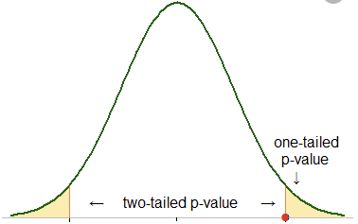
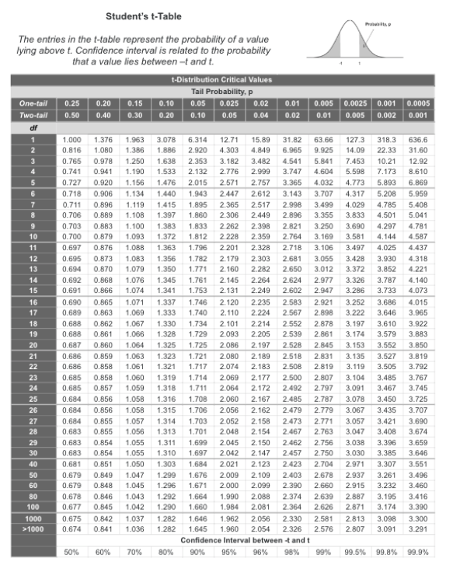
T-table
1-α
e.g. 95%
One-sided (“one-tail)
t-value is (point on the line) corresponding to the p-value (probability under the tail, e.g., α = .05, 5%) at the t-value = 1.695, at df = 30
Two-sided (“two-tail)
t-value is (point on the line) corresponding to the p-value (probability under both tail, e.g., α = .1, 10%) at the t-value = 1.695, at df = 30
Two side alpha, significance, corresponds to ½ of one-sided alpha
α₂ = α₁/ 2
*If the t-table (or function) is a one-sided table then easily convert.
α is the total percentage in the tails. For two-sided problems it is split into the two tails. For one sided problems it is all in one tail.

Slide 9

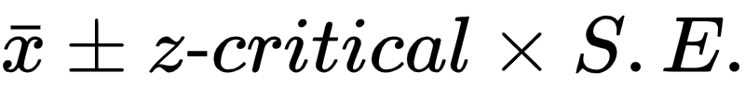
Example, confidence interval: z-statistic (Normal Distribution) for mean or proportions (std deviation known)
You take 14 longitude samples from your measurement instrument
What is the 95% confidence interval of the population mean, μ,
based on these measurements
Confidence Interval =
sample mean = 48.07
z-value = Norminv(0.95,0,1) = 1.6448 (Norminv Excel function)
q = 1 - p
S.E =sqrt(pq/n) = sqrt(.095 •.05 / 14) = 0.058248
μ = 48.07 +/- 1.6448 • 0.058248 = 48.07 +/ 0.0958
95% confidence interval = (47.974 , 48.16558 )
-z-critical
Z-critical
z-value is a point on the Normal distribution x-axis

Slide 10
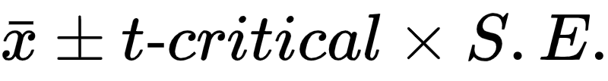
Example, confidence Intervals with t-statistic
(std deviation not known)
t-statistic for population means
You take 14 longitude samples from your measurement instrument
s = sample mean
What is the 95% confidence interval of the population mean
Confidence Interval for =
sample mean = 48.07
t-value = T.inv(0.95,13) = 1.771 (T.inv Excel function)
S.E. = s / sqrt(n)
s = sample std dev = 0.6
S.E = 0.6 / sqrt(14) = 0.160
Confidence interval = 48.07 +/- 1.771 • 0.160 = 48.07 +/- 0.2883
95% confidence = (47.7864 , 48.35386 )
t-value (t-statistic) is a point on the t-distribution x-axis

Slide 11
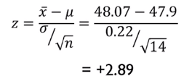
Example: Z-test hypothesis: Are the longitude measurements biased?
You suspect that your longitude measurement are biased. A person is standing at 47.9 longitude. You receive a 14 sample longitude measurements from a test device. The population is very large (e.g., you can make measurements at infinitem) and we know that our underlying longitude samples are normally distributed about the population mean (underlying distribution is normal). You want to be 95% confident in your conclusion (α = .05, significance). You know the standard deviation of the population (not usual), σ = 0.22
Step 1: state hypothesis H₀ as alternative to the assertion, H₁ is the clam (“assertion”)
H₀ : (Null Hypothesis), μ = 47.9.
H₁ : μ ≠ 47.9 … the assertion is that the population mean is closer to the sample mean than the around the supposed population mean of 47.9
two-sided test because the H₀ stated as “μ =” so both tails correspond to H₁
If H₀ stated as “μ ≤” or “≥” then one sided right or left, respectively
Step 2: Verify the conditions of inference
Step 3: Calculate the t-value (test statistic) and p-value probability in the tail(s)
Calculate the sample mean to be 48.07, calculate z-statistic, calculate probability of both tails = .0038. Thus the p-value is small (p < α), much smaller than the desired 95% confidence (α = .05), so it is very unlikely that z-statistic (z-value) falls in the tail.
Step 4: state your decision … If p ≥ α, fail to reject null, otherwise reject
Because p-value < α. Accept reject the null hypothesis. There is sufficient evidence to conclude that the measurement is biased.
p-value (tail probability)
-t-critical
z-critical
Samples
z-statistic (z-value) for population means
2(P(z> 2.89)) = 2(0.019) = 0.0038
P(z > 2.89) = 1-NORM.S.DIST(2.89,TRUE)

Slide 12


Example t-test: are the longitude measurements biased?
You suspect that your longitude measurement instrument is biased. A person is standing at 47.9 longitude. You receive a 14 sample longitude measurements from a test device. The population is very large (e.g., you can make measurements at infinitem) and we know that our underlying longitude samples are normally distributed about the population mean (underlying distribution is normal). You want to be 95% confident in your conclusion (α = .05, significance level). Note, in this case we do not know the population standard deviation (the usual case)
Step 1: state hypothesis
H₀ : (Null Hypothesis), μ = 47.9. State the Null as the alternative to the assertion.
The null always includes equality.
H₁ : μ ≠ 47.9 the assertion is that the population mean is closer to the sample mean than the around the supposed population mean of 47.9
two-sided test because the H₀ stated as equality μ “=”
If stated as μ ≤ or ≥ then one sided, right or left sided, respectively
Step 2: Verify the conditions (assumptions) of inference
Step 3: Calculate the t-value (test statistic) and p-value (two-sided test)
Reading from the table 1.06 corresponds to p-value between 0.3 to 0.2 > 0.05
Or using the excel function for two-sided p-value = 2*(1-T.DIST(1.06,13,TRUE) = 0.31
The p-value (tail probability) is large (p > α). The t statistic 95% variability could fall within the tail region.Thus, cannot conclude with 95% confidence.
Step 4: state your decision If p ≥ α, fail to reject null, otherwise reject
Because p-value > α, fail to reject the null hypothesis. There is not sufficient evidence to conclude that the measurement is biased.
-t-critical
t-critical
14 Samples
t-statistic (“t-value”, “critical value”) for population means

Slide 13
z-test references
t-test references
https://www.cliffsnotes.com/study-guides/statistics/univariate-inferential-tests/one-sample-z-test
https://www.cliffsnotes.com/study-guides/statistics/univariate-inferential-tests/test-for-a-single-population-proportion
https://www.cliffsnotes.com/study-guides/statistics/univariate-inferential-tests/two-sample-z-test-for-comparing-two-means
https://www.cliffsnotes.com/study-guides/statistics/univariate-inferential-tests/test-for-comparing-two-proportions
https://www.cliffsnotes.com/study-guides/statistics/univariate-inferential-tests/one-sample-t-test
https://www.cliffsnotes.com/study-guides/statistics/univariate-inferential-tests/two-sample-t-test-for-comparing-two-means

Slide 14
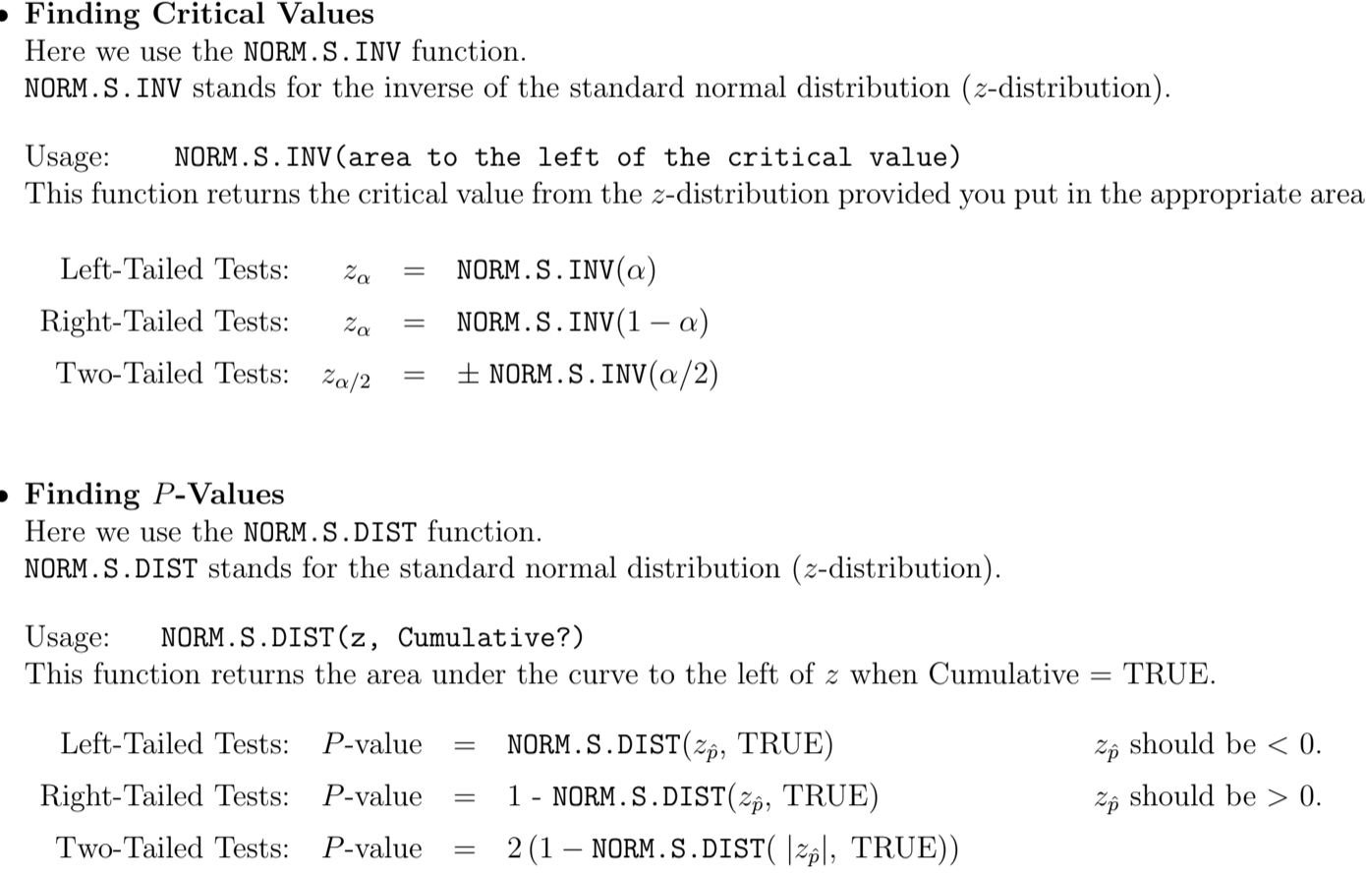
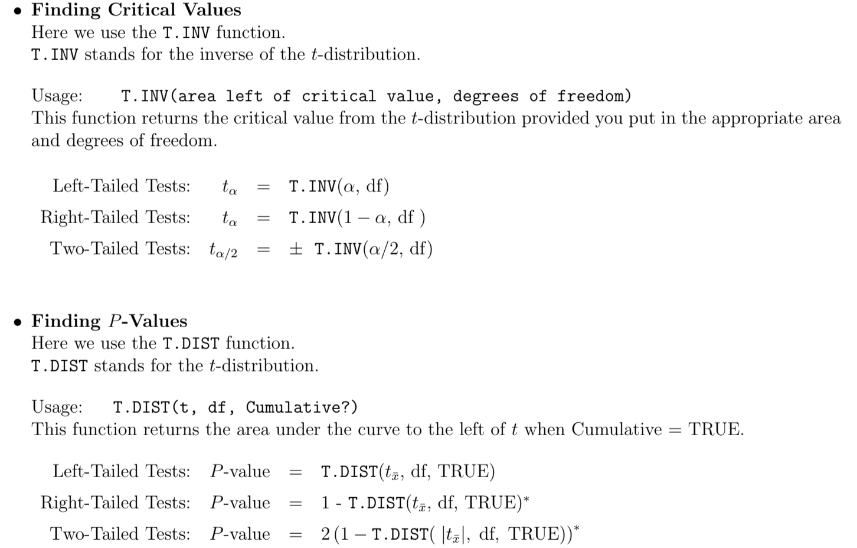
Excel t-test and z-test conversions
https://cosmosweb.champlain.edu/people/stevens/webtech/excelfiles/chap8-excel.pdf

